Slide 1

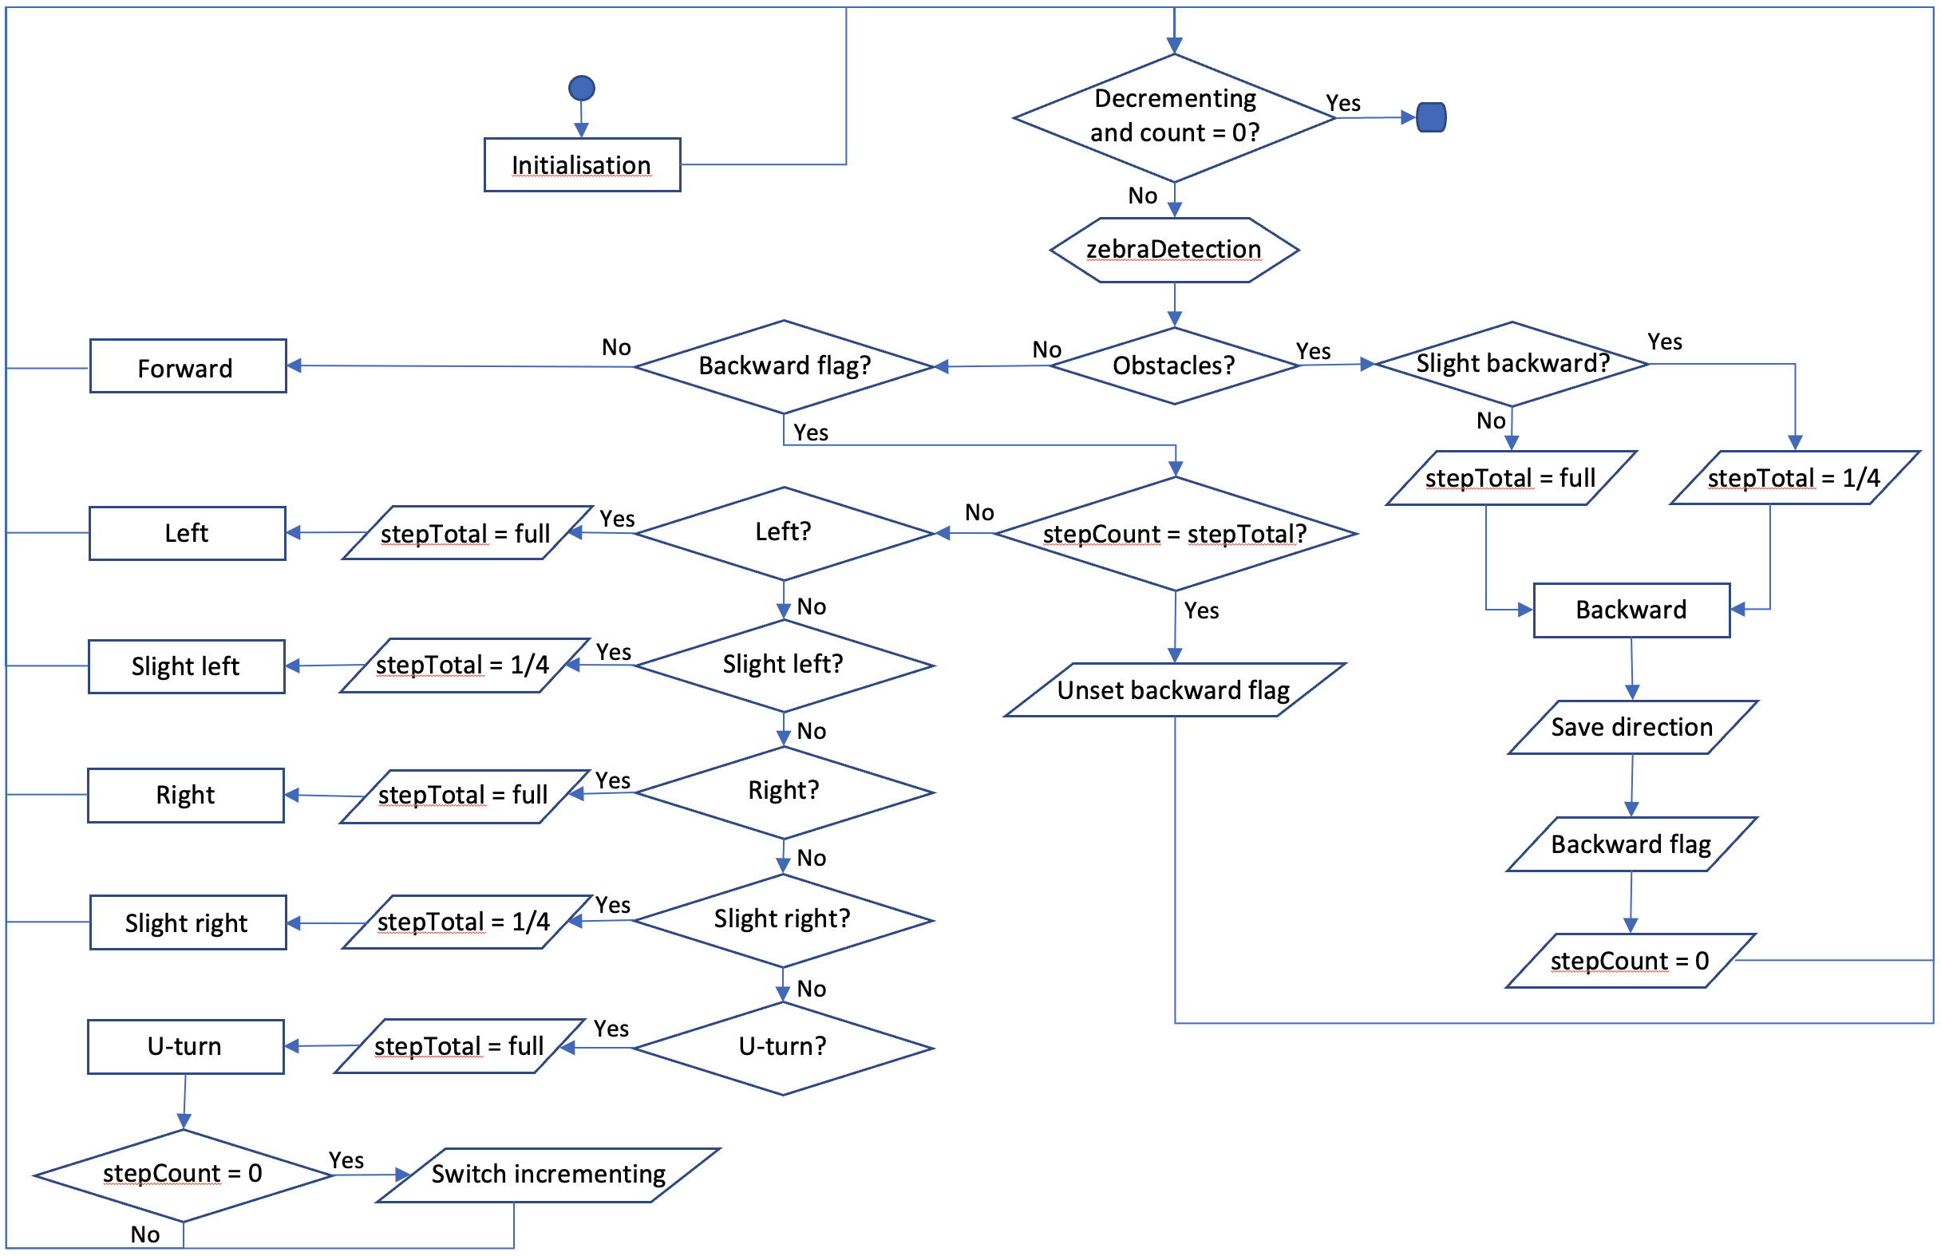
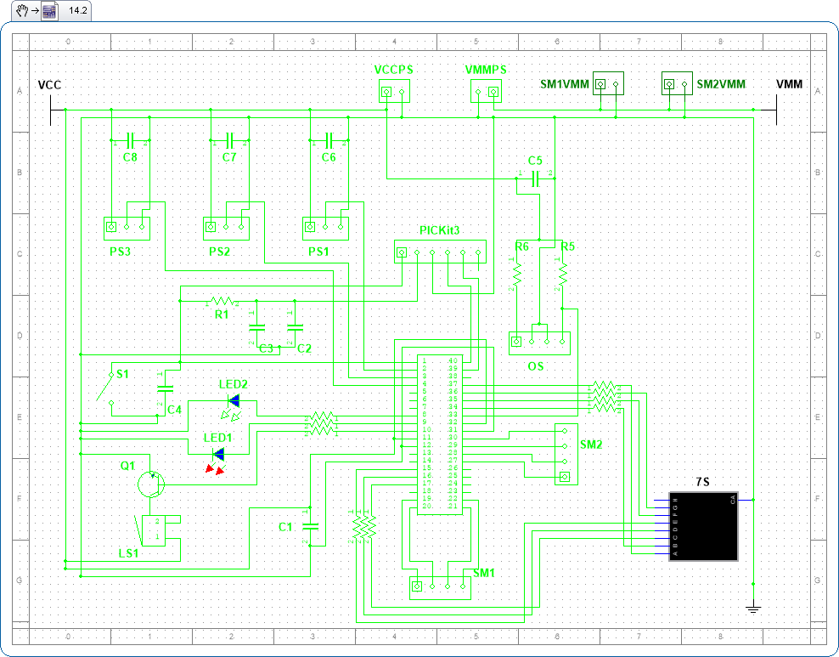
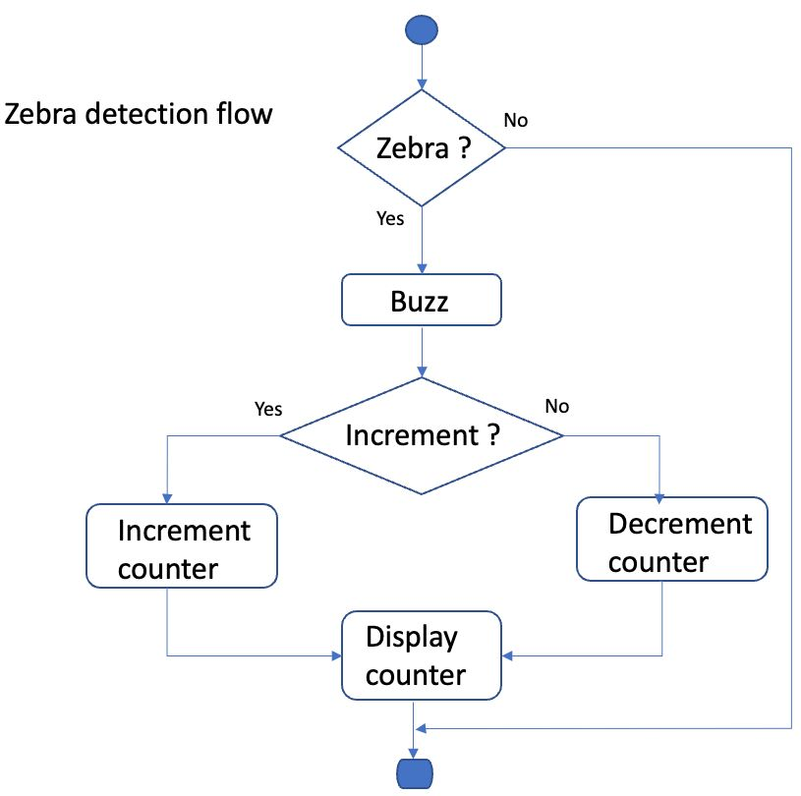
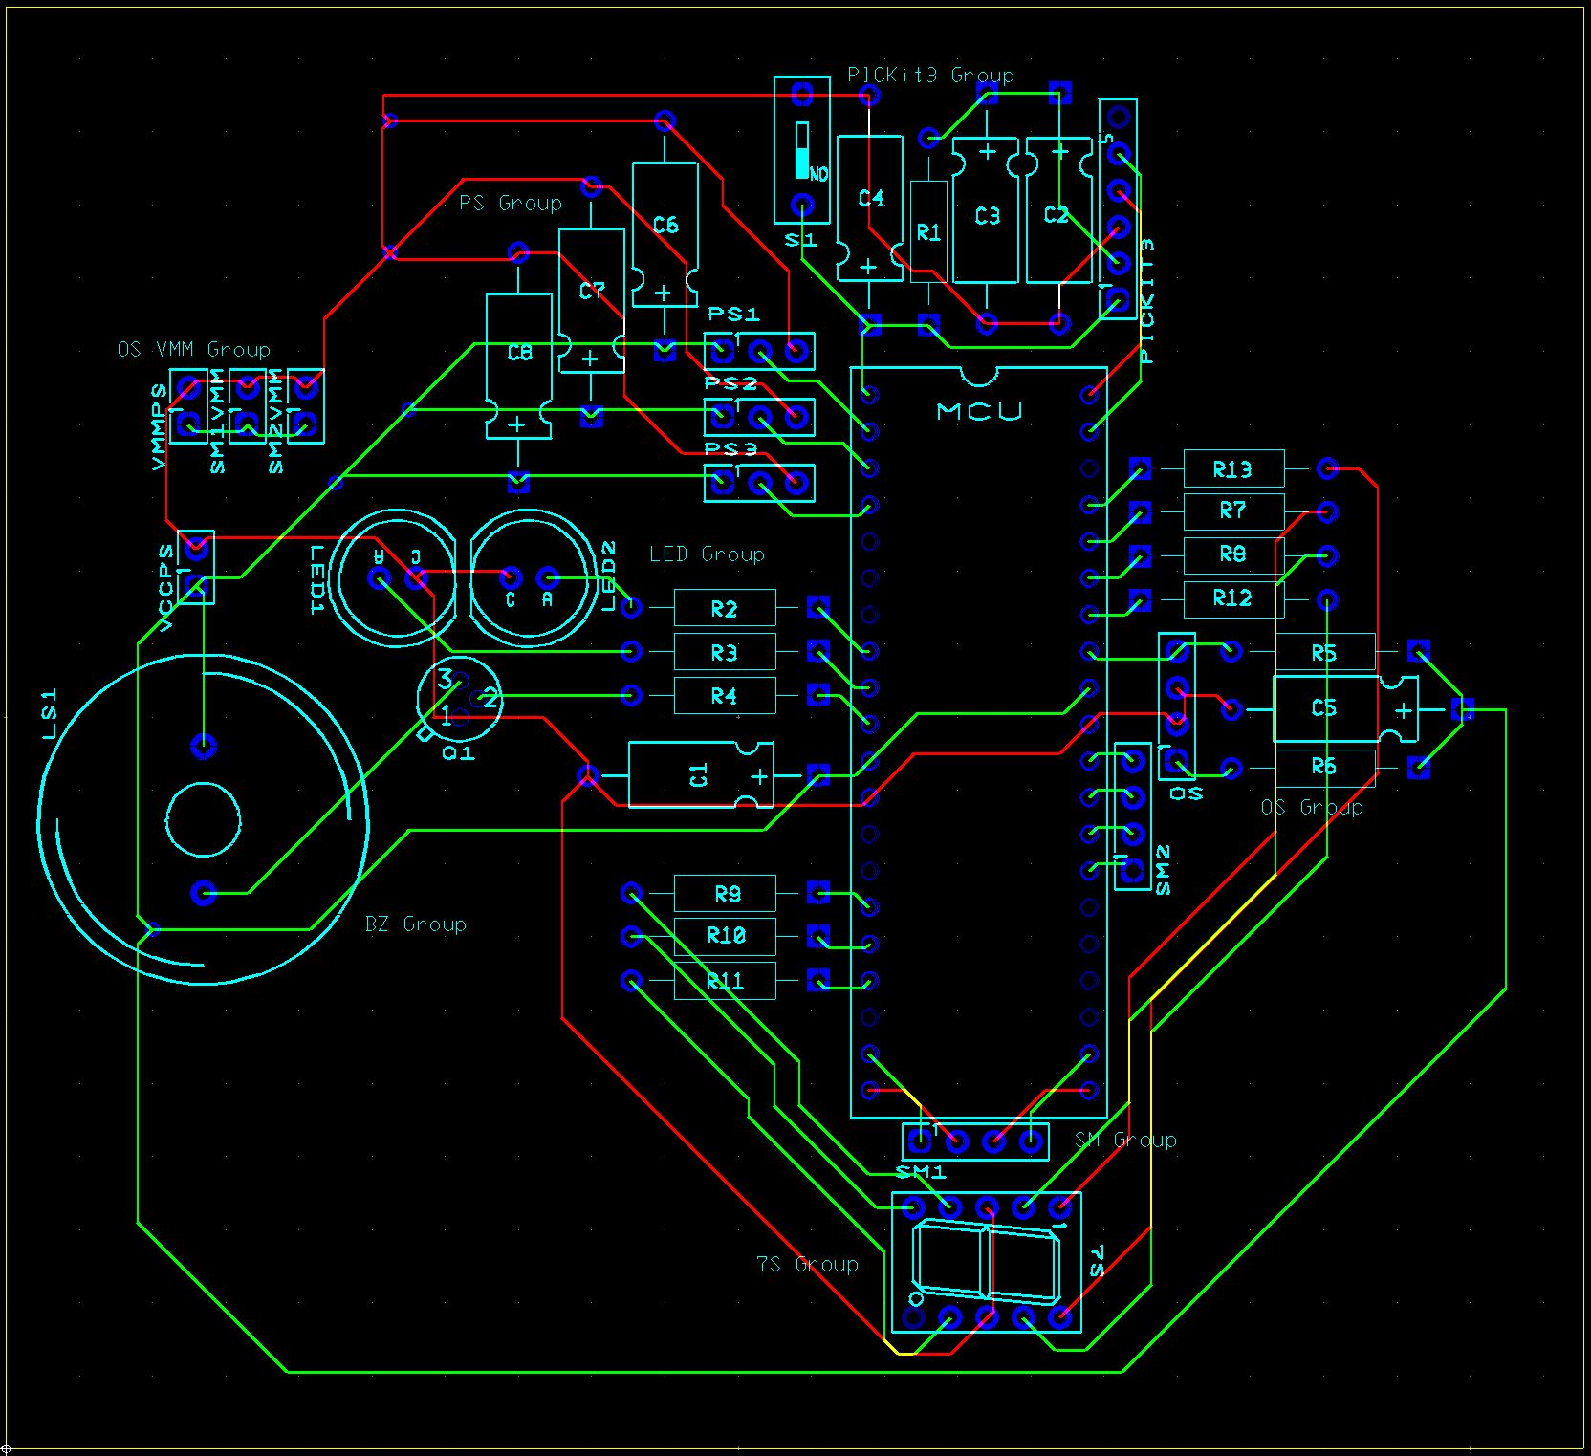
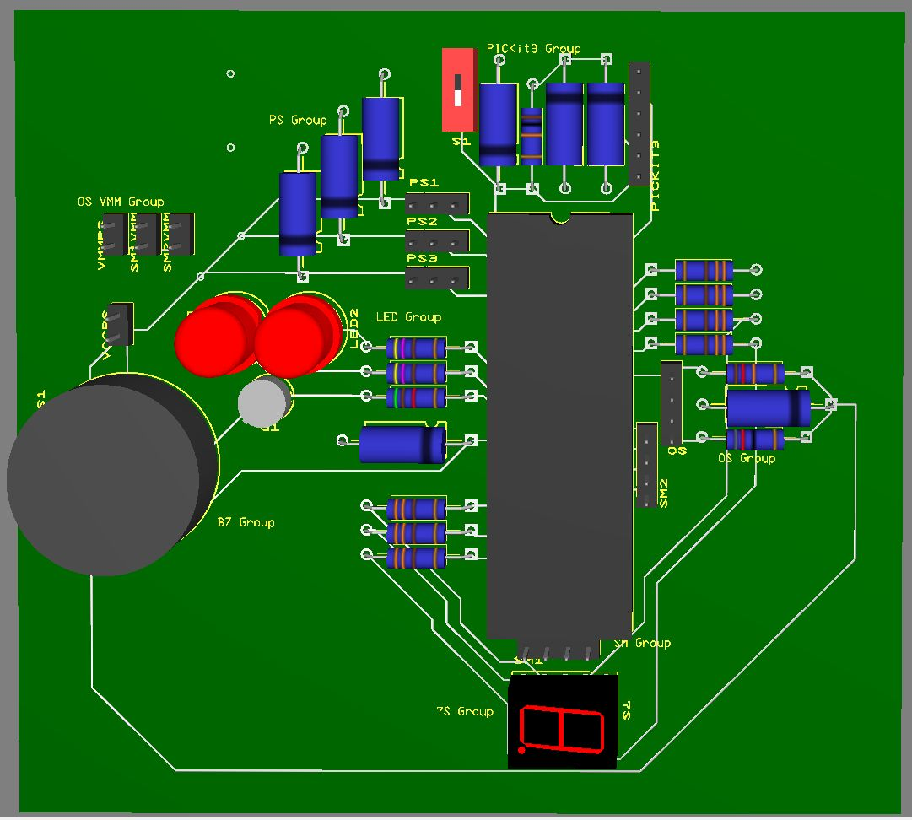
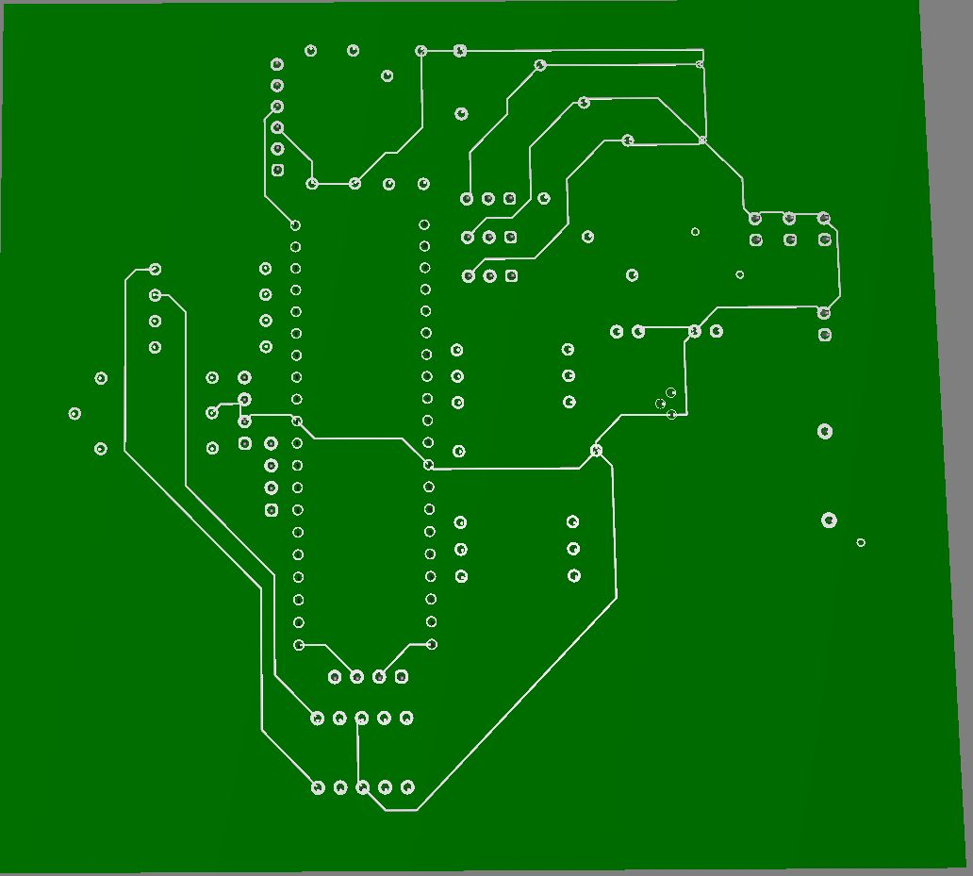
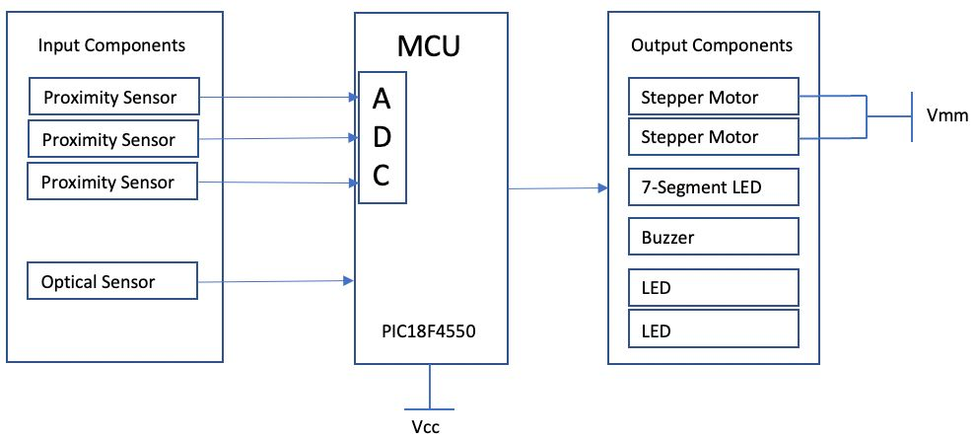
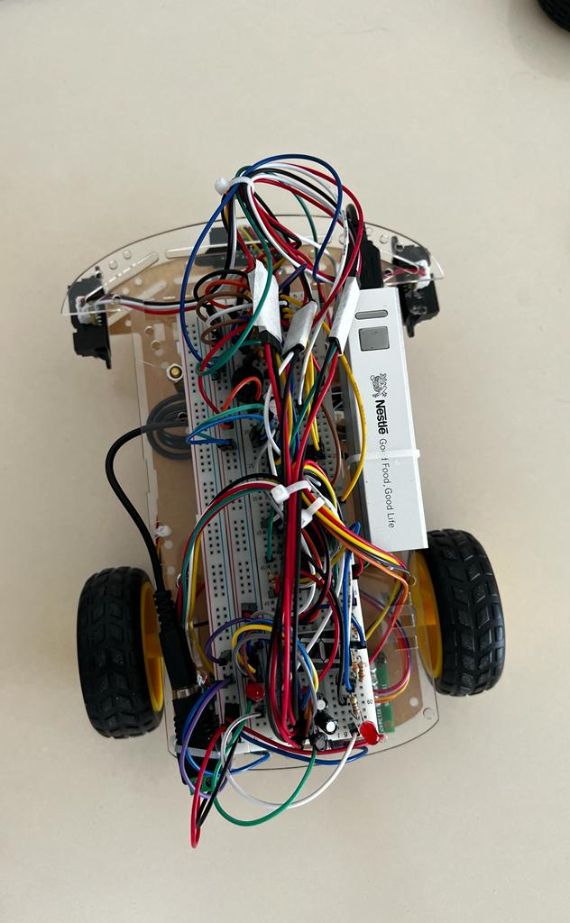
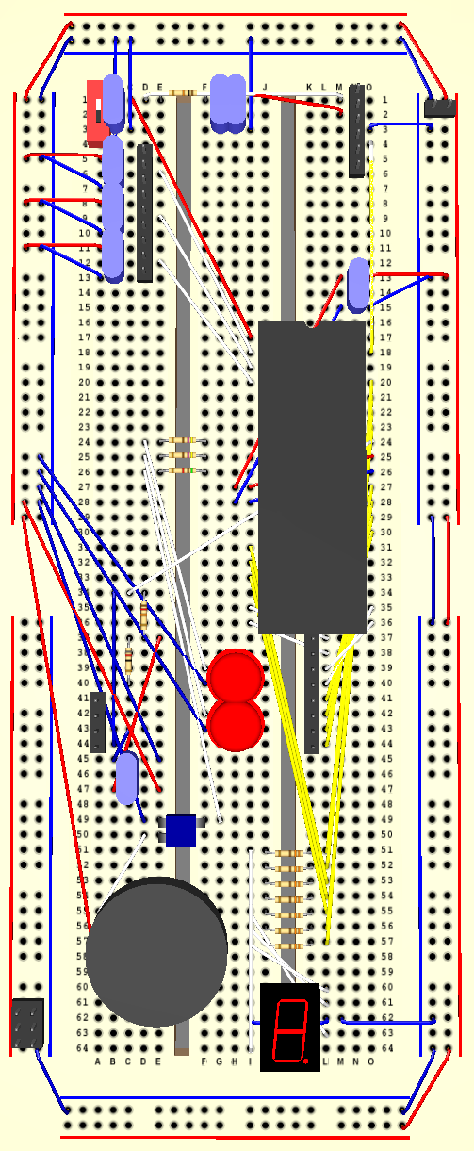
Conventry University – Bachelor of Electrical and Electronic Engineering
EMGP Assignment 1 : Design an Intelligent Navigation Robotic Vehicle
TL : Thomas Le (044WF1RX)
TM : Khor Cher (062FPACX)
TM : Teo Soon Lee (425CVGLB)
TM : Zhang Lili (005P54WJ)
Objective
Design an intelligent Navigation Robotic vehicle Design a complete hardware circuit inclusive of issued hardware Design a 15cm x 15cm PCB layout A short YouTube video clip to demo the functions of the vehicle
Flow Charts
Schematic Diagram
Main Features and Specifications
1 | Optical Sensor | Mounted at the bottom to detect the zebra markers which the vehicle passes
2 | Proximity Sensor | Mounted to the left, right, and front of the vehicle to detect any obstacles on the respective sides of the vehicle
3 | Stepper Motor | 2 stepper motors as the rear wheel of the vehicle to allow the vehicle to orientate around
4 | 7-Segment Display | Working in conjunction with Optical Sensor to display the count the increment/decrement of the number of zebras crossed
5 | Buzzer | Working along side with PS to buzz when there is detection
PCB Layout
Features of Prototype
PS2 | PS1 | PS3
1 | 0 | 1
1 | 1 | 1
PS2 | PS1 | PS3
0 | 0 | 1
0 | 1 | 1
PS2 | PS1 | PS3
0 | 1 | 0
1 | 0 | 0
1 | 1 | 0
Block Diagram
Breadboard Wiring

